Slide 1
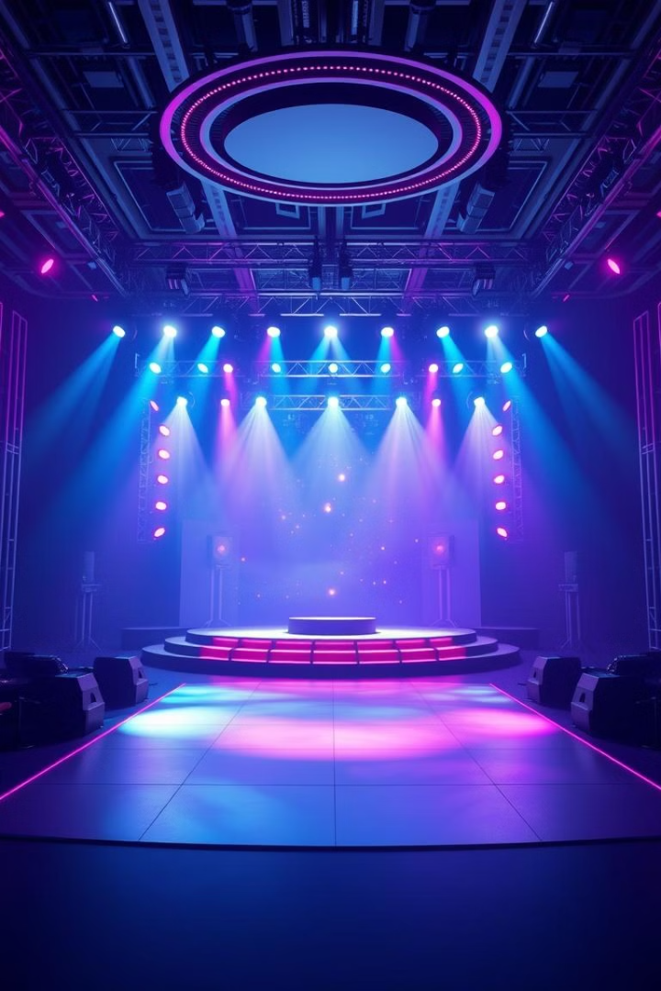
🎭 Immersive 3D Concert Experience
Experience the future of live music with our immersive 3D concert platform. This innovative platform redefines how audiences engage with music by combining cutting-edge technology with stunning visual and audio fidelity. Enjoy real-time 3D stage rendering, interactive audience seating, and AI-powered features that personalize your concert experience. With multi-camera angles and dynamic stage effects, every performance feels authentic and engaging. Join us as we revolutionize the virtual concert landscape!

Slide 2




🤖 AI-Powered Features
Smart Engagement Tracking
Dynamic Stage Effects
AI-generated visual effects that sync seamlessly with the music.
Real-time audience engagement analysis for personalized experiences.
Personalized Recommendations
AI-driven event suggestions tailored to user preferences.
Our platform leverages advanced AI algorithms to elevate every aspect of the concert experience. From smart engagement tracking to dynamic stage effects and personalized recommendations, AI ensures that each user enjoys a unique and captivating performance. The interactive chat assistant provides instant support, while sentiment analysis gauges audience reactions in real-time.

Slide 3
🎵 Superior Audio Experience
Real-Time Audio Analysis
Spatial Audio Support
Genre-Specific Audio Previews
Analyzes music in real-time to dynamically adjust visual effects, creating a synchronized audiovisual spectacle.
Immersive soundscapes that enhance the sense of presence, making you feel like you're right in the concert hall.
Tailored audio previews that highlight the unique characteristics of different music genres.
The audio experience is meticulously crafted to provide unparalleled fidelity and immersion. The spatial audio support creates a three-dimensional soundscape, while the real-time audio analysis dynamically adjusts visual effects, ensuring a captivating audiovisual spectacle. Genre-specific audio previews and dynamic equalizer settings further enhance the listening experience.

Slide 4
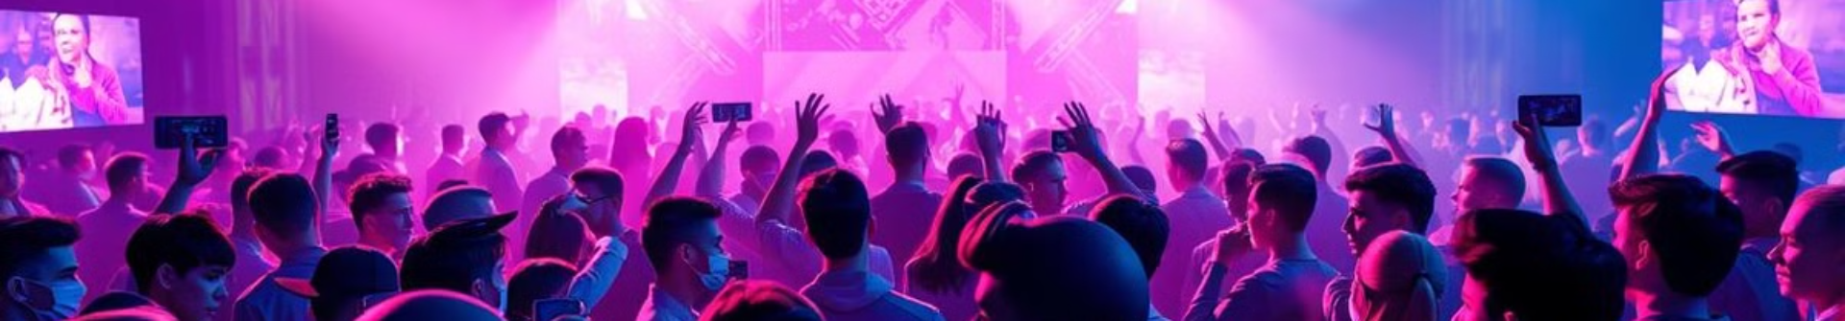
👥 Robust Social Features
Real-Time Chat
Audience Engagement Tracking
Crowd Analytics
Engage in live conversations with fellow concert-goers, enhanced by sentiment analysis to foster positive interactions.
Monitor audience reactions in real-time, providing valuable insights into the event's performance.
Gain demographic insights and understand audience composition to refine future events.
Connect with fellow music enthusiasts through our robust social features. Engage in real-time chat, enhanced by sentiment analysis to foster positive interactions. Audience engagement tracking provides valuable insights into the event's performance, while crowd analytics help organizers understand audience composition and refine future events. Experience the power of community in the virtual concert space.

Slide 5

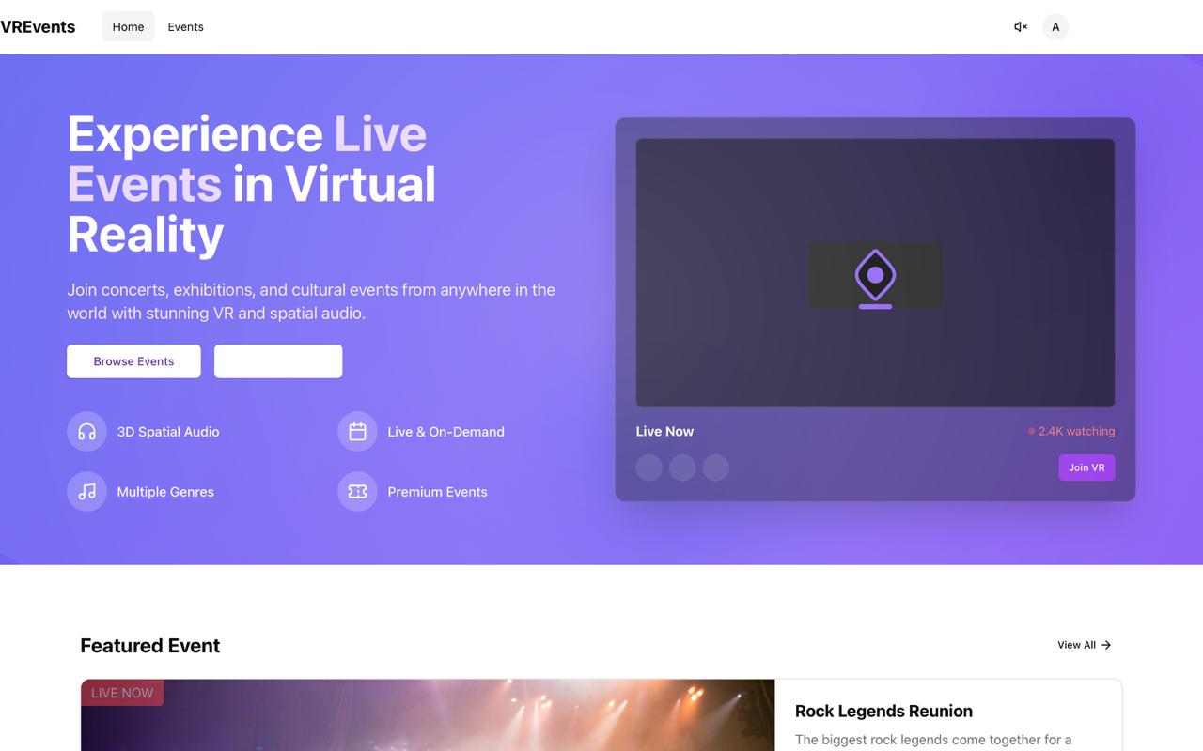



🎨 Modern UI/UX Design
Clean, Responsive Design
Ensures seamless accessibility across all devices, providing a consistent and enjoyable user experience.
Dark Mode Support
Offers enhanced visual comfort during extended use, reducing eye strain in low-light environments.
Smooth Animations
Enhance user engagement with fluid transitions and visually appealing elements.
Intuitive Navigation
Streamlines user journeys, making it easy to discover and enjoy content.
Our platform features a modern UI/UX design that prioritizes user experience. The clean, responsive design ensures seamless accessibility across all devices, while dark mode support enhances visual comfort. Smooth animations and intuitive navigation streamline user journeys, making it easy to discover and enjoy content. Dive into a visually stunning and user-friendly environment.

Slide 6



🚀 Innovative Features
1
Interactive Seating
2
Multi-Camera Angles
3
Dynamic Effects
Our platform is packed with innovative features designed to redefine the virtual concert experience. Enjoy interactive audience seating with customizable views, dynamic stage effects that respond to music in real-time, and multi-camera angles that capture the authentic feel of a live performance. Discover a new dimension of virtual entertainment with features that put you in control.

Slide 7
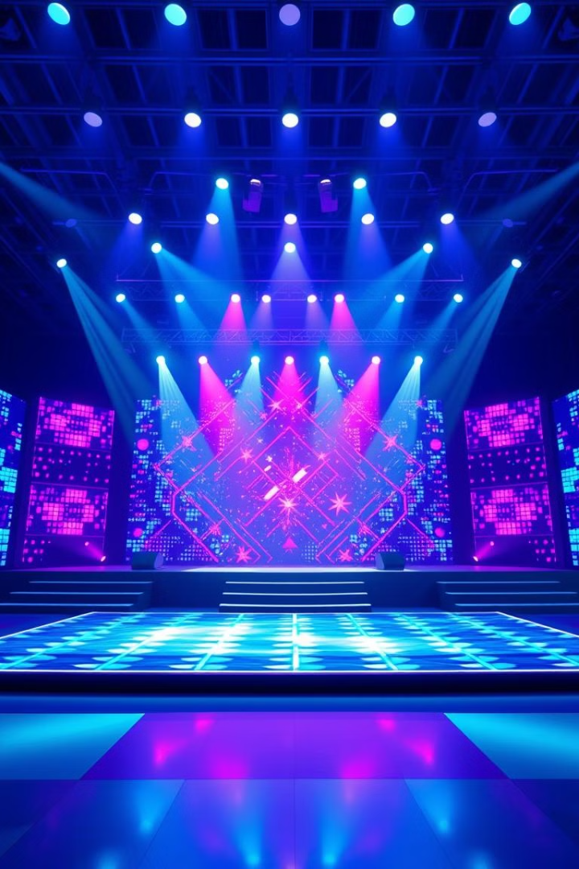




✨ AI Stage Effects
Lighting Patterns
Match the energy of the music, creating a visually stunning spectacle.
Visual Effects
Respond to bass frequencies, adding depth and intensity to the performance.
Smoke Effects
Triggered by specific audio features, enhancing the atmosphere of the concert.
Dynamic Camera Angles
Based on crowd engagement, capturing the most exciting moments.
Experience the magic of AI-generated stage effects that dynamically respond to the music. Lighting patterns match the energy, visual effects react to bass frequencies, and smoke effects are triggered by specific audio features. Dynamic camera angles capture the most exciting moments, ensuring that every performance is a unique and captivating spectacle. Immerse yourself in a world where music and visuals seamlessly blend.

Slide 8




📊 Smart Engagement System
Analyzes Chat
1
2
Tracks Reactions
Analyzes chat messages for sentiment.
Tracks audience reactions in real-time.
Generates Metrics
Identifies Moments
Generates engagement metrics for event analysis.
Identifies peak moments during events.
4
3
Our AI-powered engagement tracking system provides valuable insights into audience behavior. By analyzing chat messages for sentiment, tracking reactions in real-time, generating engagement metrics, and identifying peak moments, we help organizers understand what resonates with their audience. Use these insights to refine future events and create even more engaging experiences.

Slide 9





👤 Personalized Experience
Event Recommendations
Custom Viewing
Audio Settings
Tailored Effects
Customized viewing positions tailored to your liking.
Personalized audio settings for optimal sound quality.
Tailored visual effects based on your favorite genres.
AI-driven suggestions based on your preferences.
Our platform learns from your preferences to deliver a truly personalized experience. AI-driven event recommendations, customized viewing positions, personalized audio settings, and tailored visual effects ensure that every concert is perfectly aligned with your tastes. Dive into a world where your preferences take center stage.

Slide 10

🛠️ Cutting-Edge Tech Stack
Frontend
React, TypeScript, Three.js
UI Framework
Shadcn/ui
3D Rendering
React Three Fiber
Audio Processing
Web Audio API
State Management
Zustand
Styling
Tailwind CSS
Our platform is built on a cutting-edge tech stack, ensuring optimal performance and scalability. The frontend utilizes React, TypeScript, and Three.js, while the UI framework is Shadcn/ui. React Three Fiber powers the 3D rendering, and the Web Audio API manages audio processing. Zustand handles state management, and Tailwind CSS provides styling. This robust technology stack enables us to deliver a seamless and immersive virtual concert experience.

